Slide 1

Update - Bayesian Optimisation for Hyperparameter Tuning
Added:
‘Early Stopping’ if no improvement to score in previous x0 observations.
Monitor parameter convergence (approach to global maximum). After every 10 observations, show the top 6 scores.
Save BO object at end of each batch to enable restart.
Resolved (or identified):
Issue with negative scores; always convert to positive.
Use Expected Improvement (ei); avoid ‘ucb’s obsession with edges’.
Possible degradation as BO generates parameters as float when some xgb parameters require integer. When passing parameters to xgb, use int(round(n)) rather than int(n).

Slide 2
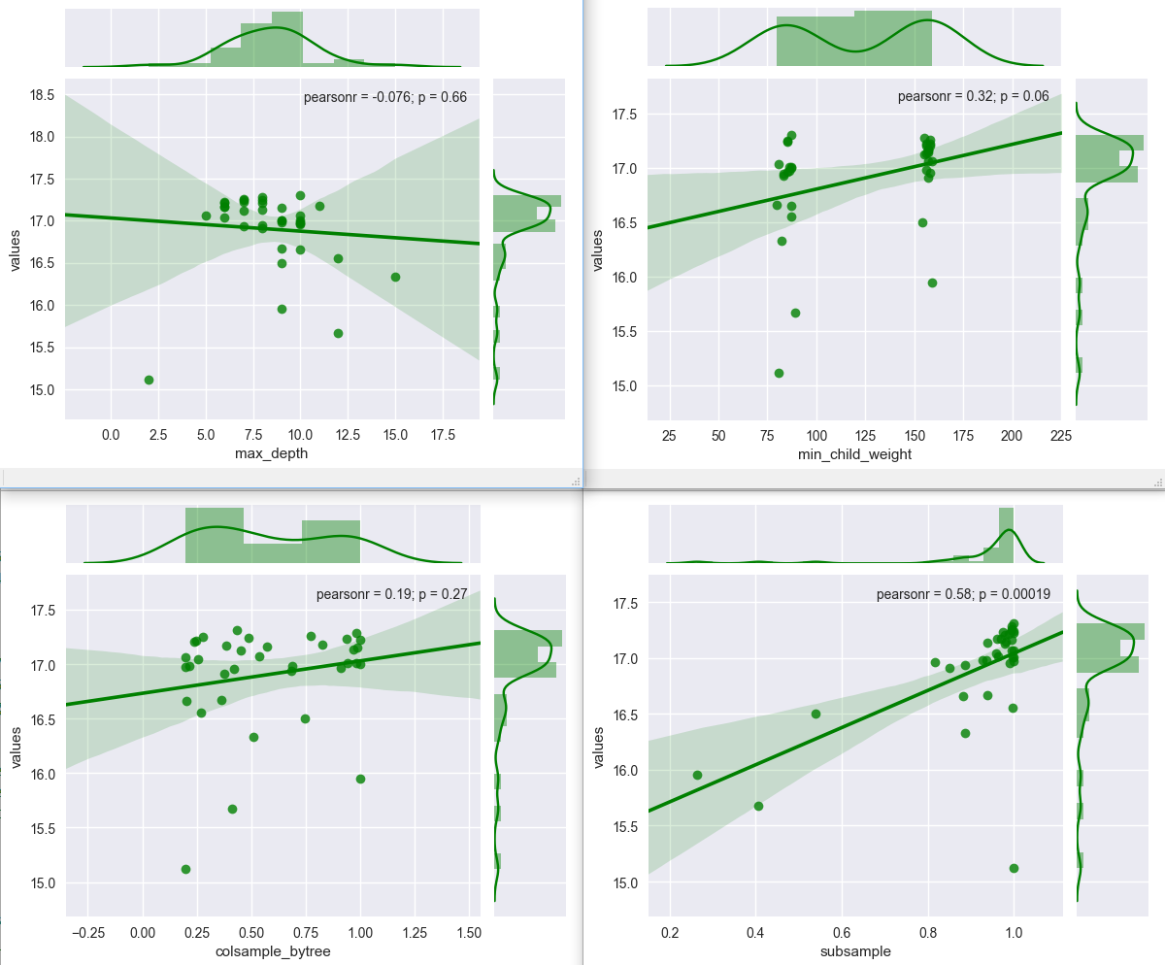
Update:
Attempted wide parameter value range for all relevant parameters.
max_depth (2, 18)
mcw (20, 200)
colsample (0.2, 1)
subsample (0.2, 1)
lambda (0)

Slide 3
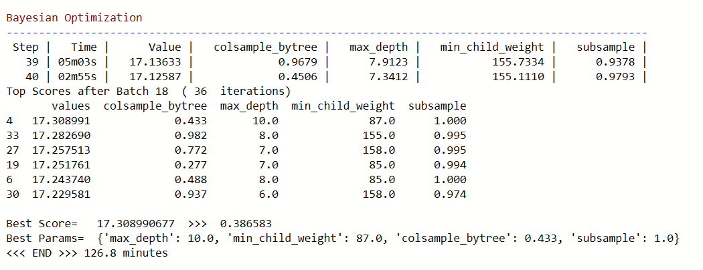
Update: Bayesian Optimisation for Hyperparameter Tuning (continued)
Output – 1
Best parameters?
.4 10 87 1
.98 8 155 1

Slide 4
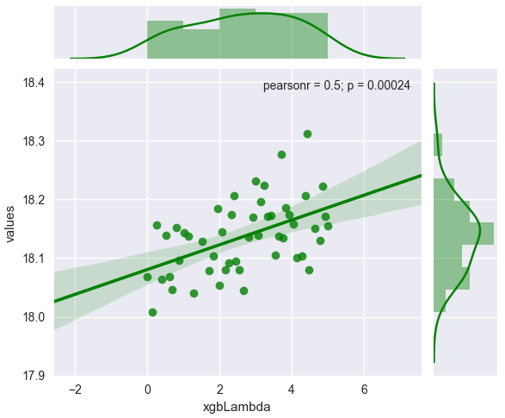
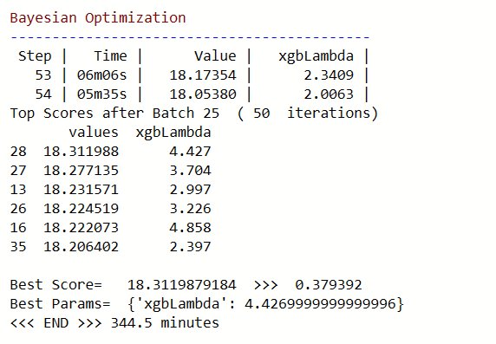
Update: Bayesian Optimisation for Hyperparameter Tuning (continued)
Candidate 1 – Lambda Tuning
max_depth (2, 18)
mcw (20, 200)
colsample (0.2, 1)
subsample (0.2, 1)
lambda (0, 5)

Slide 5
Update: Bayesian Optimisation for Hyperparameter Tuning (continued)
Final score
 | Kernel | Last Meetup
max_depth | 10 | 9
min_child_weight | 50 | 130
colsample_bytree | 0.3 | 0.65
subsample | 0.8 | 1
gamma | 0 | 0
lambda | 1 | 0
eta | 0.3 | 0.3
Candidate 1
10
87
0.4
1
0
3
0.3
Candidate 2
8
155
0.98
1
0
3
0.3
Public LB Score:
.38948 221st
. 38379 188th
.38xxx 2xx^{st}
.38xxx 2xx^{st}
After increasing number boost rounds to 200 and lambda=1

